Slide 1
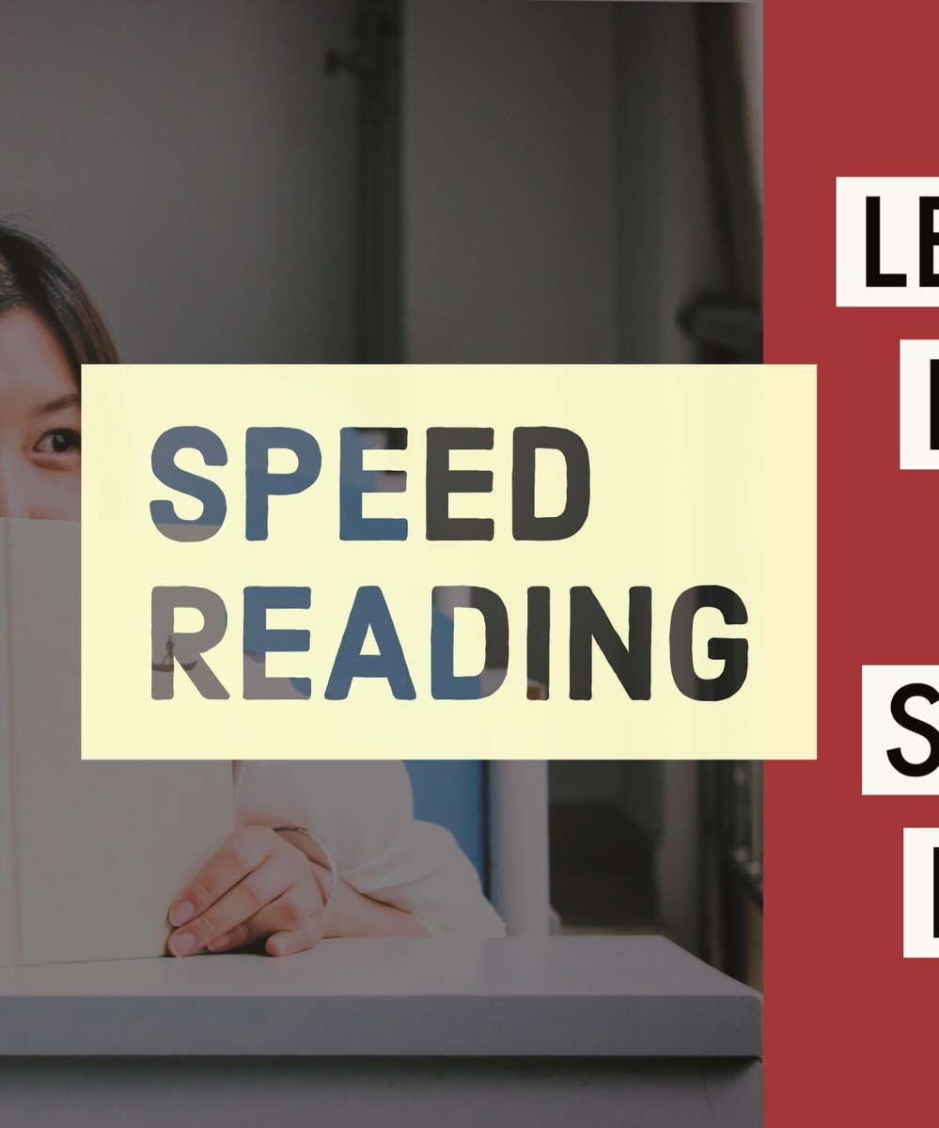
Speed Reading Enhancer
App that summarizes articles and books into concise insights to free up time for what's important

Slide 2



Benefits
Read more books
Process information faster
Free up time
Speed reading allows you to get through more books in less time.
You can quickly scan documents and absorb key information.
The time saved from speed reading can be used for hobbies, exercise, socializing.
Speed reading is a valuable skill that allows you to read faster and free up time for the activities you enjoy.

Slide 3
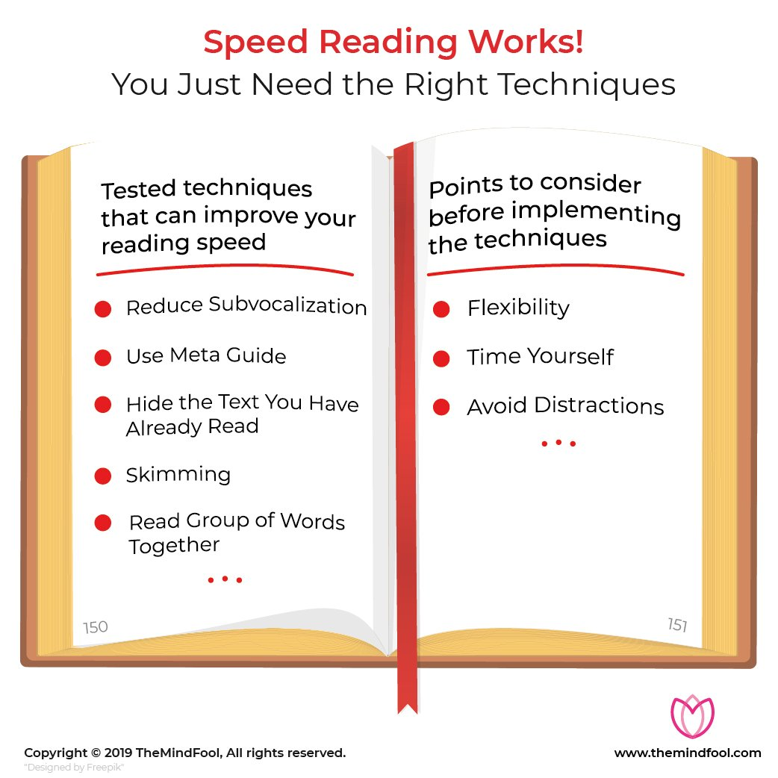
How It Works
Speed reading techniques like skimming, scanning, and chunking text can help readers absorb information more efficiently. By eliminating subvocalization and increasing pace, speed reading enhances comprehensi

Slide 4
Tips
Use a pointer
Use a pointer like your finger or a pen to guide your eyes while reading. This can help focus your eyes and attention
First and last sentences
Pay extra attention to the first and last sentences of each paragraph. These often contain the main ideas.
Chunk phrases
Practice reading by chunks of phrases instead of individual words. This helps absorb meaning more quickly

Slide 5
“Time Saver - Slash book stacks and articles into bite-sized wisdom, freeing up valuable time for your passions
Document

Slide 6
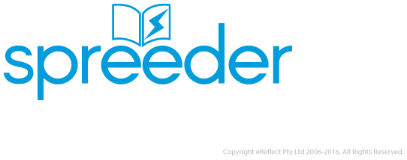
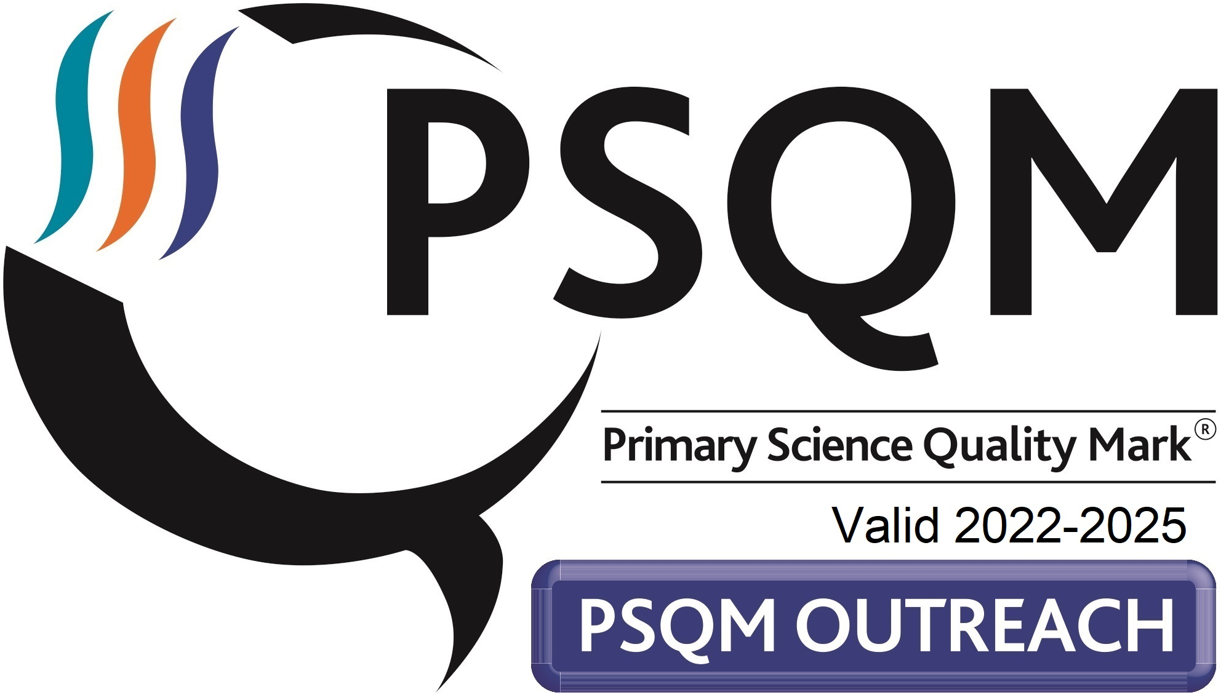
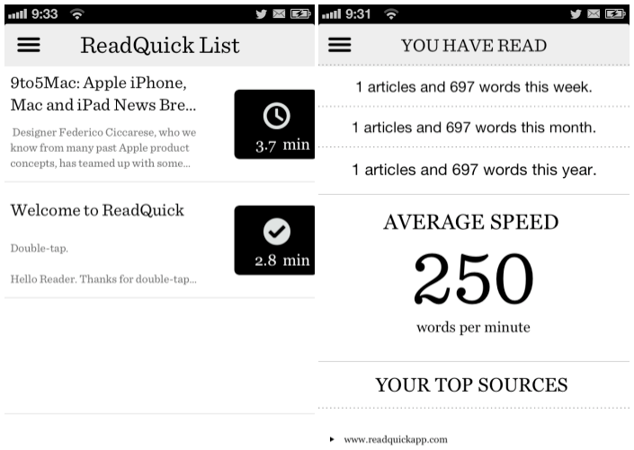
Programs

Slide 7
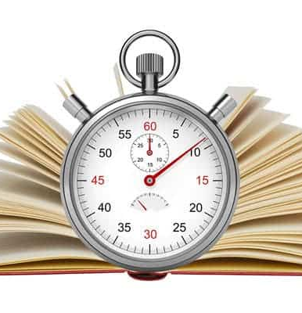
Results
With regular practice of speed reading techniques like skimming, scanning, and chunking text, many people find they can double or even triple their reading speed while still comprehending the main ideas. This allows them to get through more material in less time, freeing up hours for other pursu

Slide 8



Expert Level
Pages Read per Minute
Word Retention Rate
Reduction in Reading Time

Slide 9
Conclusion
Speed reading allows people to absorb information much faster than normal reading. With practice, most individuals can significantly boost their reading speed and retention

